Slide 1
Predicting Rentals in Bike Sharing Systems
Research Task in Statistics
FAL001 // 3 April, 2025
Bhavay Singhal
Matriculation Number: 5126210
Supervisor: Ms. Jing Zou
Professor: Dr. Ostap Okhrin

Slide 2
INTRODUCTION

Slide 3
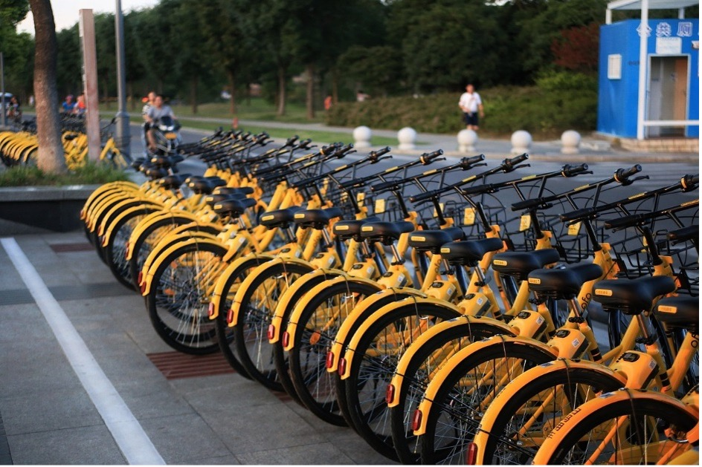
Advantages To Adopt Bike Sharing Systems
Traffic Congestion
Gaps in the network, first-and-last mile connectivity
COX and NOX emissions
Replace motorized trips

Slide 4

Motivation for Demand Prediction
Frequent re-balancing: reliable short-term demand prediction, high spatial resolution
Can also aid maintenance planning
Greater granularity than daily demand
Reduce Lost Demand

Slide 5
CitiBike
New York City, U.S.

Slide 6
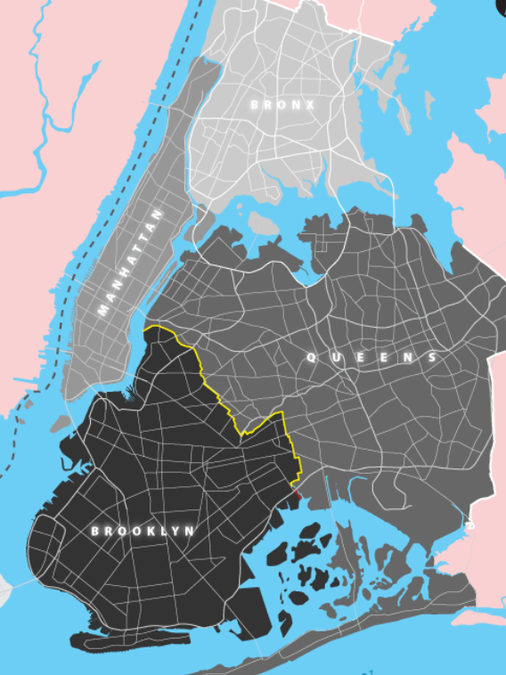
Initial Launch Areas - 2013
Lower Half of Manhattan
Pockets of Northwest Broolyn
Program expanded to outer boroughs
Reasons for Area Selection during launch
High Population Density
Commercial & Residential Mix
Very Good Transit Connectivity

Slide 7
SCOPE OF THE STUDY
Ensembles of Decision Trees

Slide 8

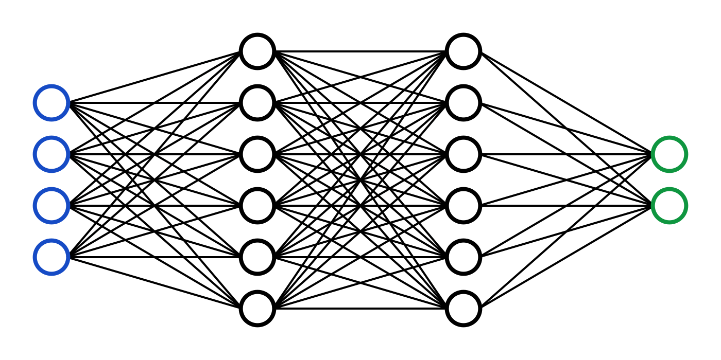
Advantages of Ensembles of Decision Trees over DL
Less Data
Better Interpretability
Higher Training Speed
Fewer Computational Resources
Less Tuning
More Robust to Outliers
Simpler Implementation

Slide 9
Short-term v/s Long-term Demand Prediction
Short term Demand Prediction (15 minutes – few hours ahead):
More data required, captures rapid demand fluctuations
complex non-linear relationships
Addresses immediate operational challenges )
Long term Demand Prediction (Weekly/Monthly patterns):
Less data required, captures broader trends
Simple linear relationships
Addresses planning issues

Slide 10

Project’s Goals
Develop High Quality Features
Bridge the gap between short-term & medium-term forecasting
Bench-marking different tree-based ensembles

Slide 11
DATASET
Generated using CitiBike’s System Data

Slide 12
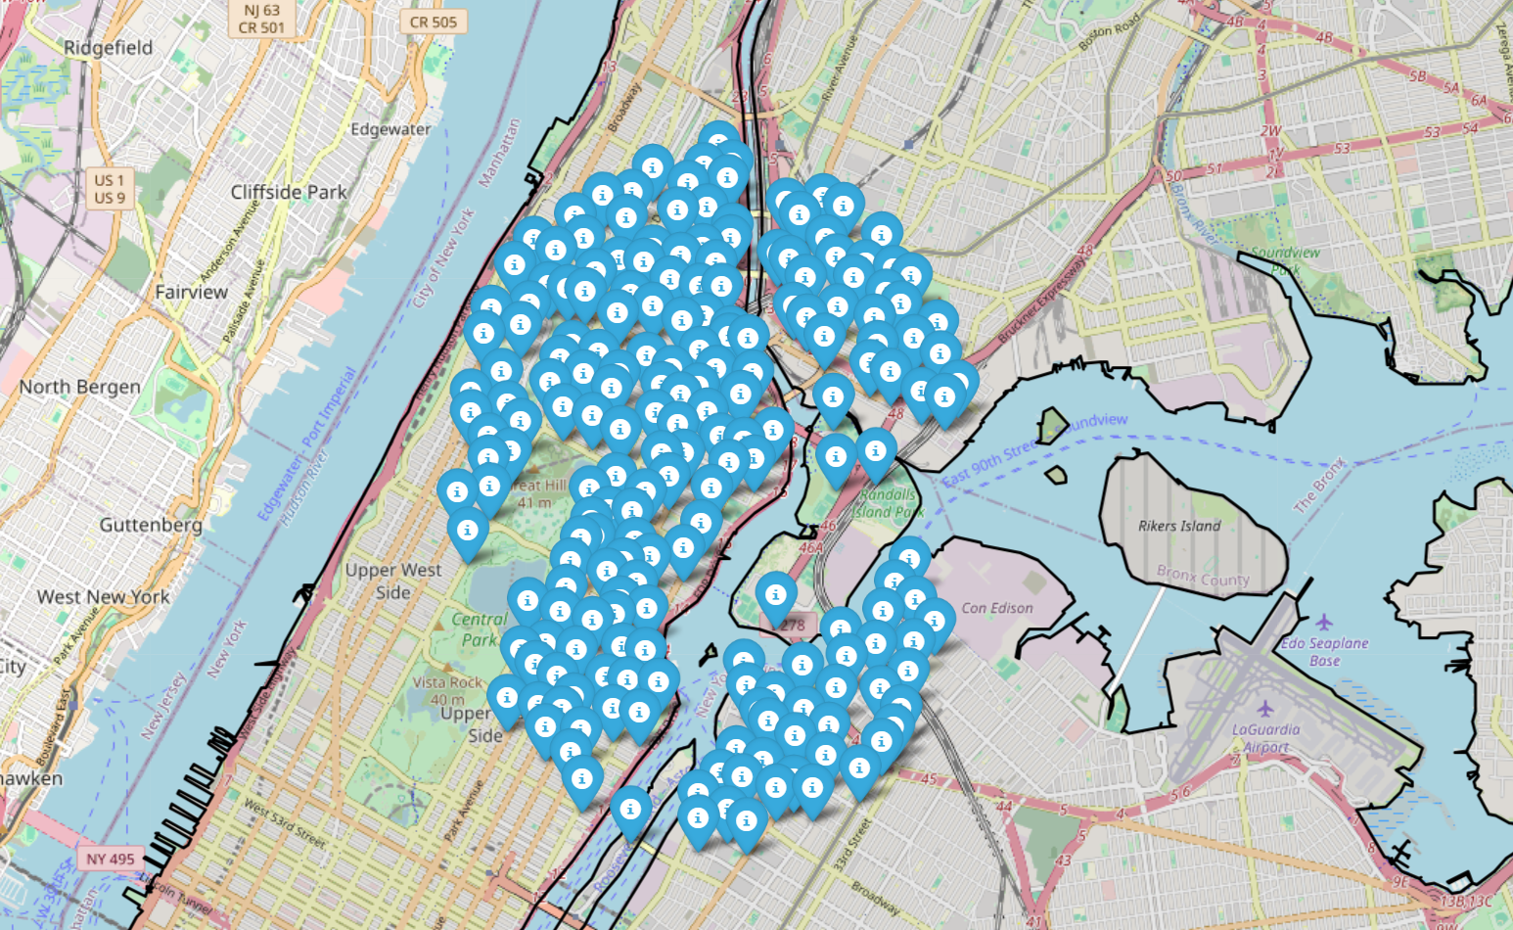
Data Description
Original CitiBike system data: OD Data
Contains spatial and temporal information
First 4 months of 2024, 200 stations
Demand Calculation: Trips originating from a station are aggregated
Mid and Upper Manhattan + Bronx + Queens

Slide 13

Time Resolution: Seven 2-hour chunks in a day
08:00:00.000 (denotes time window: 8.00 – 10.00)
10:00:00.000 (denotes time window: 10.00 – 12.00)
12:00:00.000 (denotes time window: 12.00 – 14.00)
14:00:00.000 (denotes time window: 14.00 – 16.00)
16:00:00.000 (denotes time window: 16.00 – 18.00)
18:00:00.000 (denotes time window: 18.00 – 20.00)
20:00:00.000 (denotes time window: 20.00 – 22.00)

Slide 14
FEATURE ENGINEERING
Available + Developed Features

Slide 15
Features Used in the Baseline Model
Aggregated number of rentals
Month Number
Day Number
Hour
Start Station ID
Aggregated rentals lagged by one time unit

Slide 16
Baseline Model: Random Forest
Analysis done over two months separately – Feb and March
Training Data: first 25 days
Test Set: Remaining days of the month
Performance on Test Set:
Feb 2024: 2.722 (MSE) and 0.256 (r2 score)
Mar 2024: 3.915 (MSE) and 0.444 (r2 score)

Slide 17
Developed Feature 1: Weather Information (Meteostat)
Temperature
Relative Humidity
Precipitation
Wind Speed
Weather Condition Code

Slide 18
Developed Feature 2: Rentals lagged by two time units
Similar to rentals lagged by one time unit
Calculated at station level, for each date and hour
Developed Feature 3: Weekend Indicator (Binary Variable)
takes value ‘1’ if weekend,
else ‘0’

Slide 19
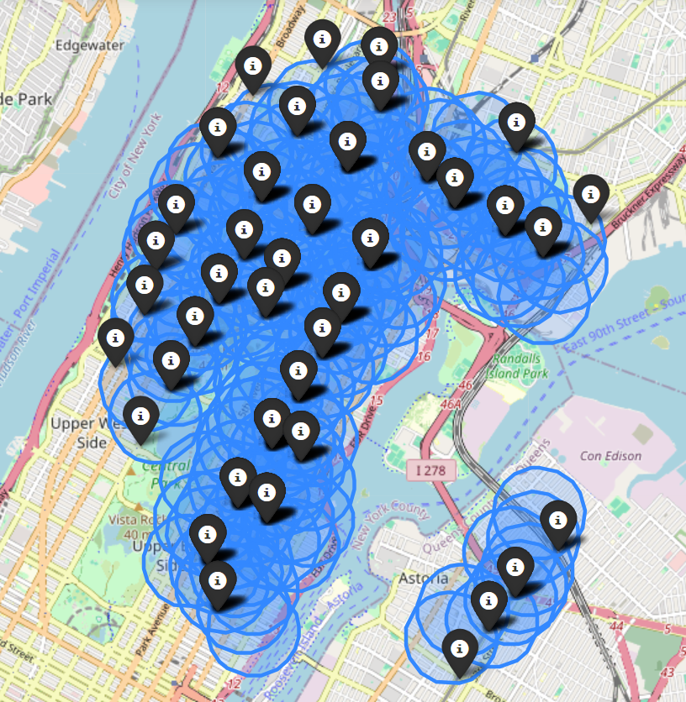
Developed Feature 4: Number of Subway Stations nearby
Subway stations highly correlated with rentals
Bike stations within 400m of subway
Bubway stations counted within a ‘buffer’ zone
Bike stations better differentiated with 800m buffer

Slide 20
Developed Feature 5: Name of Day
Day Number is replaced with Name
Developed Feature 6: Previous Day Rentals
Number of Rentals made at same station, same hour, one day before
Developed Feature 7: Rolling Average, Past 7 days
Rentals Value averaged over 7 prior days
Calculated for the same station, same hour of day

Slide 21
Developed Feature 8: Rush Hour Indicator (Binary Varaiable)
Mean value of rentals made (all stations):
1.676694214876033 (hour 8-10)
1.3396280991735536 (hour 10-12)
1.5396694214876032 (hour 12-14)
1.7802892561983472 (hour 14-16)
2.0058677685950412 (hour 16-18)
1.448099173553719 (hour 18-20)
0.6651239669421488 (hour 20-22)
Max, Median value of rentals made:
31, 1 (hour 8-10)
34, 1 (hour 10-12)
48, 1 (hour 12-14)
78, 1 (hour 14-16)
67, 1 (hour 16-18)
37, 1 (hour 18-20)
14, 0 (hour 20-22)
Indicator is “1”, if hour belongs to window
Else, “0”

Slide 22
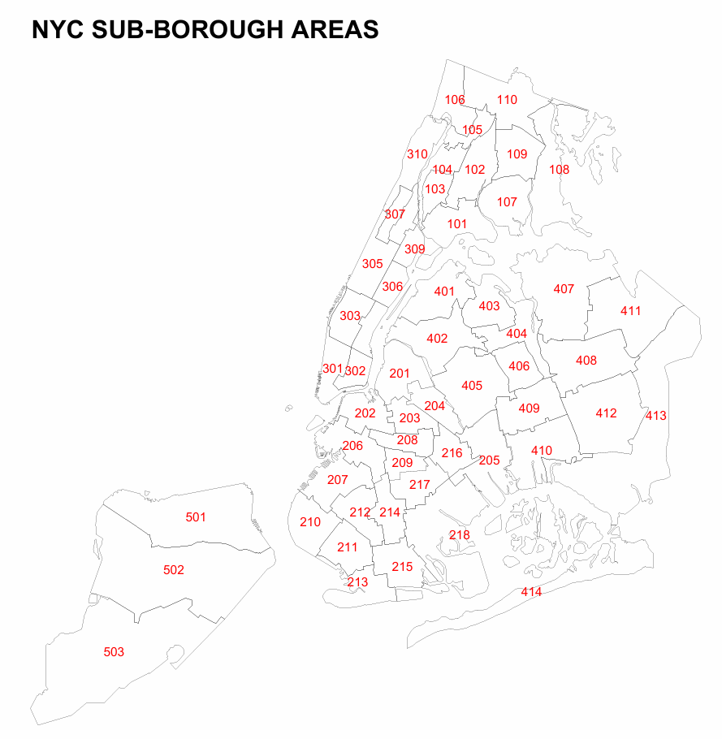
Developed Feature 9: Borough & Sub-Borough Information
MapID: 3 digit code, unique to each sub-borough
First digit: Main Borough
Remaining two digits: Sub-Borough Area Code
Meant to capture broader spatial trend

Slide 23
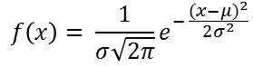
Developed Feature 10: Rentals lagged by a time unit, only from nearby stations
Nearby stations are assigned weights (Gaussian Kernel)
Higher weights for closer distance and vice versa
Spatial weights stored in a weight matrix (unique to a station)
Weighted Average is determined

Slide 24
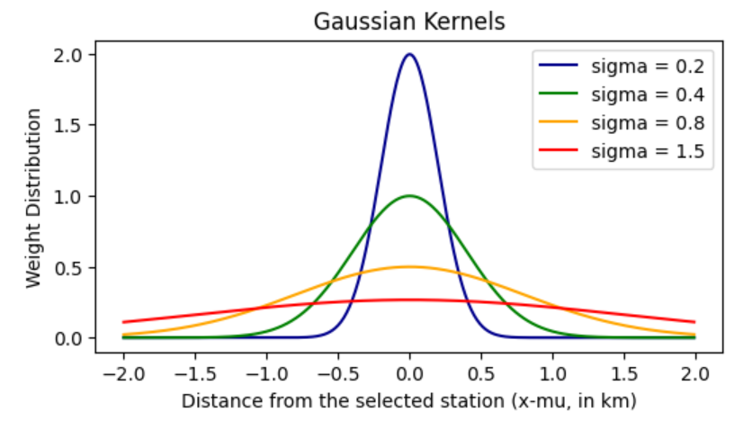
Developed Feature 10: Cont’d
Works better than absolute average or entering nearby stations manually
Appropriate sigma-value: 0.4
Higher weights for distance within 500m
Weights decrease up till 1 km
No weights farther than 1km

Slide 25
Developed Feature 11: Rentals from Previous Day, from nearby stations
Similar to ‘Previous Day Rentals’ feature
Except, only ‘other’ stations are considered
Weighted Average using Gaussian Kernel
Over Rentals from Previous Day, Same Hour

Slide 26
Developed Feature 12: Rolling Average of rentals, from nearby stations
Similar to ‘Rolling Average from past 7 days’ feature
Except, only ‘other’ stations are considered
Weighted Average using Gaussian Kernel
Over Average Rentals from 7 Days prior, Same Hour

Slide 27
Developed Feature 13: Rentals Lagged by 2 Time Periods, from nearby stations
Similar to ‘Rentals Lagged by two time units’ feature
Except, only ‘other’ stations are considered
Weighted Average using Gaussian Kernel
Over Rentals from same day, two time units prior

Slide 28
Feature Importance: Descending Order, by MSE drop from baseline
Borough and Sub-borough Information (i.e. MapID): MSE dropped by 0.5
Weather Information: MSE dropped by 0.436
Day of week (name of day): MSE dropped by 0.38
Weekend Indicator: MSE dropped by 0.34
Lagged Rentals from nearby stations, by one time period (Gaussian Kernel): MSE dropped by 0.313
Rentals from previous day, from nearby stations (Gaussian Kernel): MSE dropped by 0.244
Rolling average, over past 7 days: MSE dropped by 0.215
Rentals from rolling average, from nearby stations (Gaussian Kernel): MSE dropped by 0.21
Lagged Rentals from nearby stations, by two time periods (Gaussian Kernel): MSE dropped by 0.17
Previous Day Rentals: MSE dropped by 0.16
Rentals lagged by 2 time units: MSE dropped by 0.13
Number of subway stations nearby: MSE dropped by 0.04
Rush Hour Indicator: MSE dropped by 0.04

Slide 29
DATA SEGMENTATION & FEATURE SELECTION

Slide 30
Data Segmentation (Bigger Training Set)
Sets Used: Training, Validation and Test
Training and Testing for both March and April, each
Validation Set (tuning done for Mar only): Week prior to last week of March used
Same hyperparameter values in both models
Designed to preserve temporal order
Test Sets: Last Week of Month (performance is averaged)
Training Sets: 6 weeks prior to 3rd week of month

Slide 31
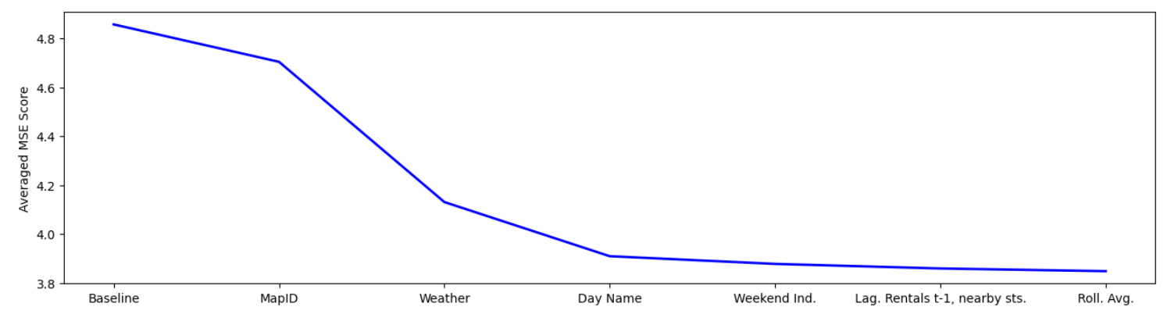
Feature Selection (Baseline: RF with default hyperparameters)
Features are incrementally added to the baseline (following feature importance)
Baseline Features are same as used before

Slide 32
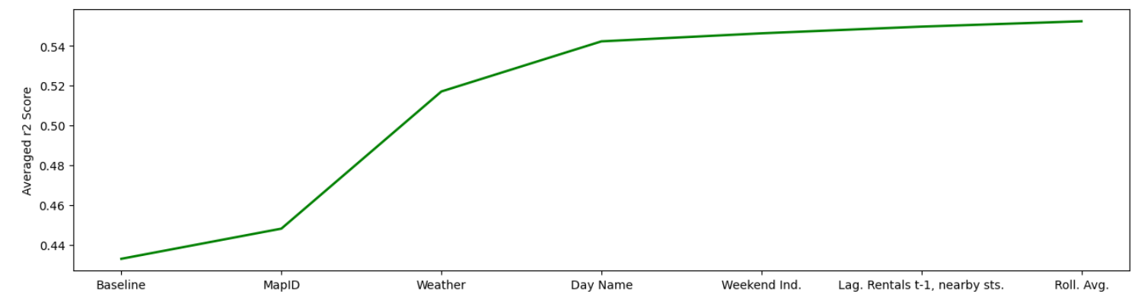
Feature Selection (Baseline: RF with default hyperparameters)
Adding more features doesn’t improve performance
Only 6/13 generated features contribute to performance increase

Slide 33
Performance on Test Set: Baseline versus Full Model
NOTE:
6th feature “weighted avg of previous day rentals, from nearby stations” harming performance
Replaced with the successor in feature importance i.e. ‘Rolling Avg, 7 days prior’ – led to improvement
Model (RF, defualt) | Avg MSE | Avg r2 score
Baseline Features | 4.85 | 0.43
6 Features Added | 3.84 | 0.55

Slide 34
MODEL SELECTION & TUNING

Slide 35
Hyperparameter Tuning - Methodology
Random Search Method Used
CV Disabled (preserving temporal order)
Validation Set to determine performance: 3rd week of March 2024
Best hyperparameters found: Used both in Mar and Apr models
Only the most essential hyperparameters are tuned (learner dependent)

Slide 36
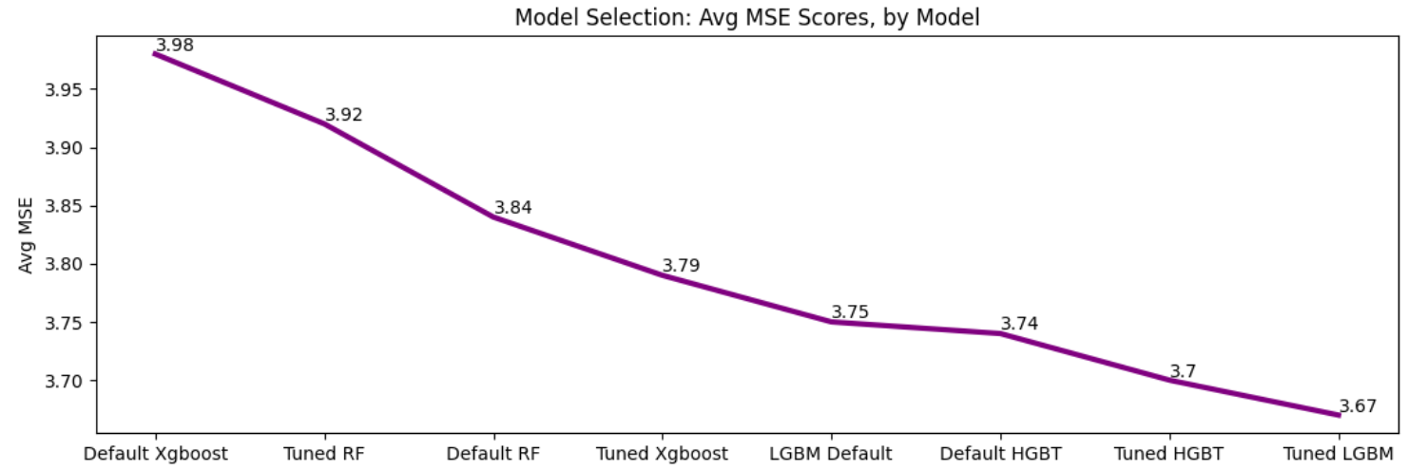
Hyperparameter Tuning – Results (MSE)

Slide 37
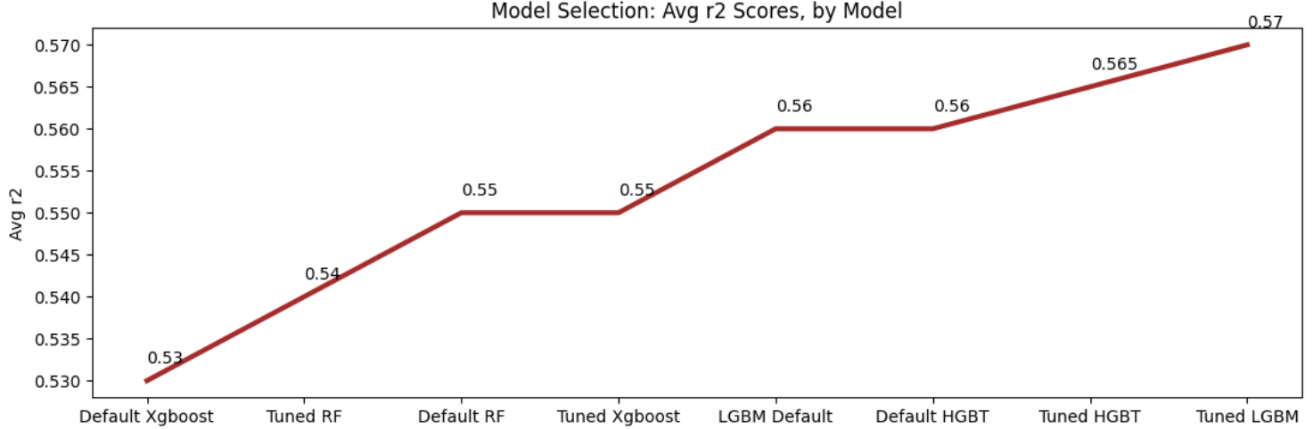
Hyperparameter Tuning – Results (r2 score)

Slide 38
Learner 1: Random Forest
Not very sensitive to hyperparameter tuning
For most datasets, default hyperparameters work well
Hyperparameters Changed:
n_estimators (number of trees in forest)
max_depth (max depth allowed for a tree)
min_samples_split (min samples required for internal node splitting)
min_samples_leaf (min samples required to be a leaf node)
Tuning led to poorer performance (default values are better)

Slide 39
Learner 2: Histogram-based Gradient Boosted Trees
Not very sensitive to hyperparameter tuning
Requires minimal tuning, not many hyperparameters
Default hyperparameters performed better than RF
Hyperparameters Changed:
learning_rate — best value: 0.08
max_iterations — best value: 300
Tuning led to slightly better performance (compared to default HGBT)

Slide 40
Learner 3: Light Gradient Boosted Machines
Very sensitive to hyperparameter tuning
Requires careful tuning (many hyperparameters)
Default hyperparameters performed better than RF
Performance poorer compared to default HGBT
Tuning led to performance improvement over default hyperparameters

Slide 41
Learner 3: Light Gradient Boosted Machines (Cont’d)
6 hyperparameters changed:
n_estimators (number of trees) — best value: 340
learning_rate — best value: 0.1
num_leaves (maximum tree leaves) — best value: 30
max_depth (maximum tree depth) — best value: 25
reg_alpha (L1 regularization) — best value: 0
reg_lambda (L2 regularization) — best value: 0.5

Slide 42
Learner 4: Xgboost Regressor
Can perform better compared to RF and HGBT
Very sensitive to hyperparameter tuning
Requires careful tuning (many hyperparameters)
Default hyperparameters performed worse than RF (poorest of all)
Tuning led to performance improvement over default hyperparameters (and RF)
Tuned model still poor compared to LGBM and HGBT

Slide 43
Learner 4: Xgboost Regressor (Cont’d)
5 hyperparameters changed:
n_estimators (number of trees) — best value: 300
learning_rate — best value: 0.07
max_depth (maximum tree depth) — best value: 7
subsample (portion of data used, per tree) — best value: 0.6
reg_lambda (L2 regularization) — best value: 1.2

Slide 44
CONCLUSION

Slide 45
How ‘good’ is prediction performance?
If only mean rentals are predicted in the test set:
Avg MSE: 8.59
RMSE: error of ~ 2.93 bikes
With Tuned LGBM:
Avg MSE: 3.67
RMSE: error of ~ 1.9 bikes

Slide 46
Limitations
Advanced tuning might be required to extract more performance from the learners
For better performance, DNN based learners might be needed
Instead of singular splits, CV methods dedicated to time series data preferred
MSE scores for April were consistently higher than March (higher variance, data drift…..)

Slide 47
Thank You For Your Attention!

